Slide 1
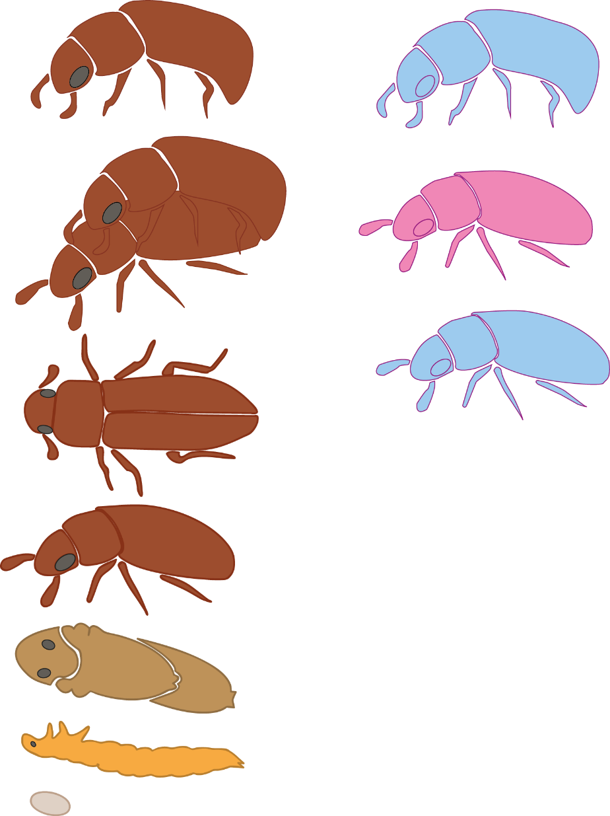
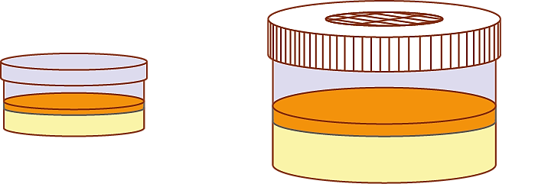
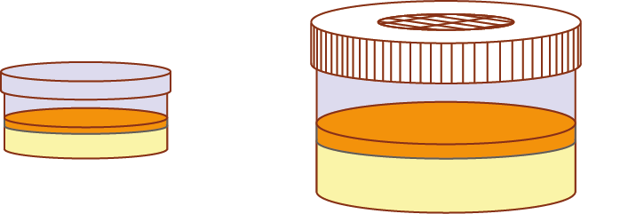


Adaptation methods
Adaptation:
Ancestry
5-Day exposures
Mate
Oviposit
Cool regime
30ºC
30ºC
38ºC
42ºC
Warm regime
30ºC
38ºC
38ºC
42ºC
Notes:
THE MALE HAS HAD HIS FUN CAN BE COMMITED TO SPERM ASSAYS WHILE FEMALES LEFT TO OVIPOSIT FOR OFFPSRING COUNTS
Standard protocol so the only thing that changes is the unavoidable difference in generation.
Males can be dissected to look at fertility, females oviposit in flour and oats; 10 days is our standard however, we have data for 20.
Development of offspring can be tracked by sieving, counting and replacing.
Males had his fun

Slide 2
Thermal adaptation protocol
Ancestry
5-Day exposures
Mate
Oviposit
Cool regime
30ºC
30ºC
38ºC
42ºC
Warm regime
30ºC
38ºC
38ºC
42ºC
Notes:
THE MALE HAS HAD HIS FUN CAN BE COMMITED TO SPERM ASSAYS WHILE FEMALES LEFT TO OVIPOSIT FOR OFFPSRING COUNTS
Standard protocol so the only thing that changes is the unavoidable difference in generation.
Males can be dissected to look at fertility, females oviposit in flour and oats; 10 days is our standard however, we have data for 20.
Development of offspring can be tracked by sieving, counting and replacing.
Males had his fun

Slide 3
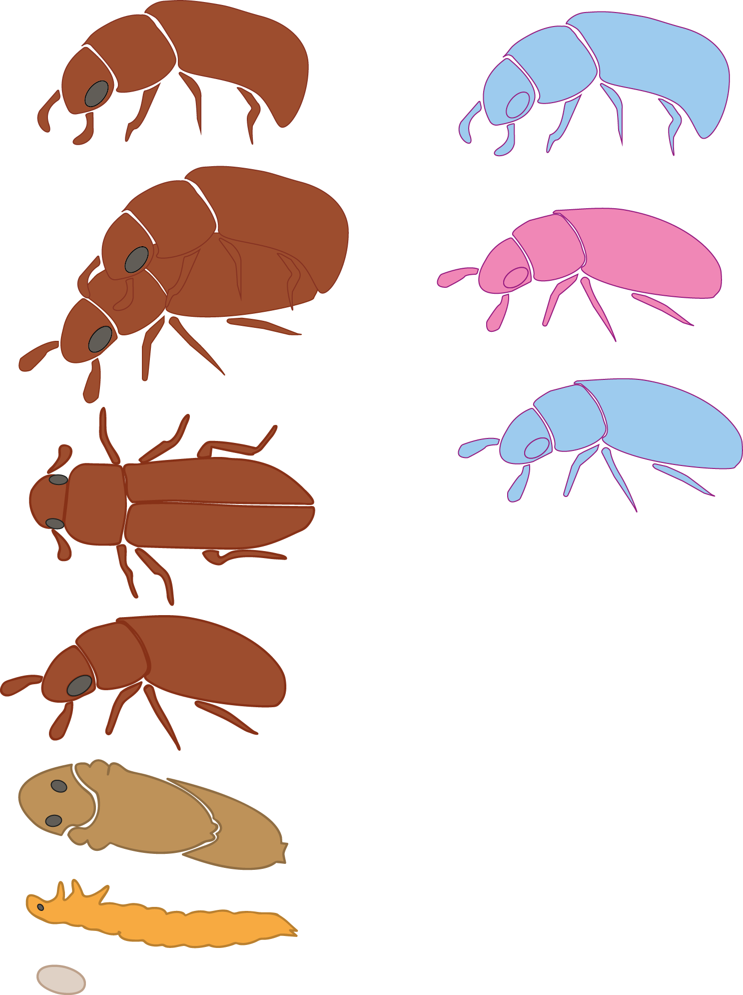

Potential adaptation to heatwave methods
Adaptation:
Ancestry
Developmental Acclimation
5-Day Heatwave
Mate
Oviposition
Egg to adulthood
Cool regime
30ºC
42ºC
Warm regime
38ºC
42ºC
Notes:
THE MALE HAS HAD HIS FUN CAN BE COMMITED TO SPERM ASSAYS WHILE FEMALES LEFT TO OVIPOSIT FOR OFFPSRING COUNTS
Standard protocol so the only thing that changes is the unavoidable difference in generation.
Males can be dissected to look at fertility, females oviposit in flour and oats; 10 days is our standard however, we have data for 20.
Development of offspring can be tracked by sieving, counting and replacing.
Males had his fun

Slide 4
Thermal acclimation protocol
Developmental Acclimation
5-Day Heatwave
Oviposition
Ancestry
Mate
Egg to adulthood
30ºC
Cool regime
42ºC
30ºC
38ºC
30ºC
Warm regime
42ºC
38ºC
38ºC
Notes:
THE MALE HAS HAD HIS FUN CAN BE COMMITED TO SPERM ASSAYS WHILE FEMALES LEFT TO OVIPOSIT FOR OFFPSRING COUNTS
Standard protocol so the only thing that changes is the unavoidable difference in generation.
Males can be dissected to look at fertility, females oviposit in flour and oats; 10 days is our standard however, we have data for 20.
Development of offspring can be tracked by sieving, counting and replacing.
Males had his fun

Slide 5
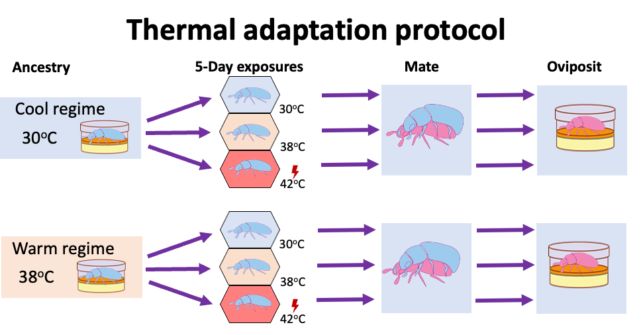
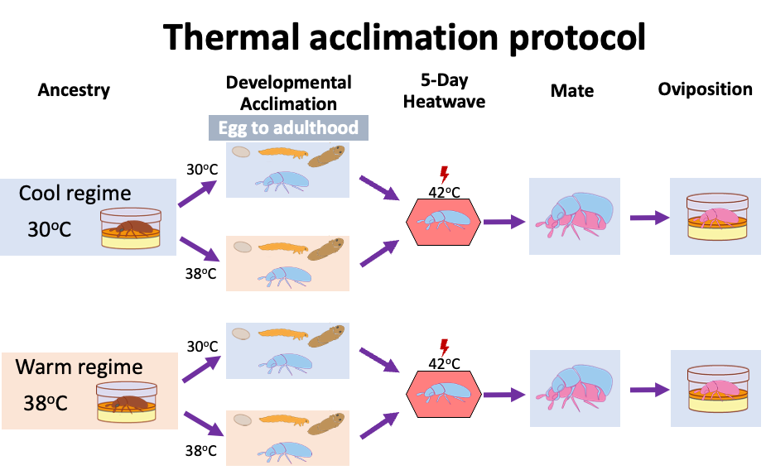
a
b

Slide 6
